Slide 1
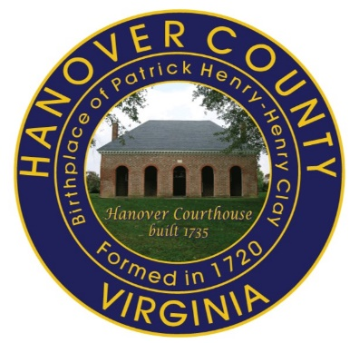
Hanover Early Childhood Council
Imagining… Dolly Parton’s
Imagination Library
For Hanover’s Youngest Residents
August 2017
Notes:
Presenter Notes: (Remember to highlight that we are a workgroup of professionals and citizens interested in advancing services and public awareness of the important of early childhood education with no formal budget )

Slide 2
Hanover Early Childhood Council
The Hanover Early Childhood Council promotes the goal of ensuring that all children, prenatal-five years, are healthy, well cared for, and have a good start on life.
The Early Childhood Workgroup Membership:
Representatives from various local government departments, schools and libraries.
Community stakeholders and leaders including representatives of preschool and child care providers, faith-based providers, business and non-profits that specialize in services for this population
Smart Beginnings of the Greater Richmond Area
Notes:
Presenter Notes: Quick Introduction About the Council (Remember to highlight that we are a workgroup of professionals and citizens interested in advancing services and public awareness of the important of early childhood education with no formal budget )

Slide 3
Hanover Early Childhood Council
Sample Initiatives:
Regional Kindergarten Registration Campaign
Hanover Kindergarten Registration Resource Bags
“Parents Come with Lots of Questions” Resource Sheet (English and Spanish)
Hanover Home Visiting Program –free in-home Parent Educator conducts routine visits to help parents of preschool children (infants to age 5) learn parenting skills, child development, enrichment activities to ensure positive growth & development. Partnership with Family Lifeline & Hanover
Notes:
Presenter Notes: 800 Kindergarten Registration bags each year to local elementary schools with resources, activity item and early reader book. Multiple copies of the Parents Resource Sheet available. Home Visiting Program open to any mom who is in need of support. To get more info on Home Visiting Program contact 249-5414

Slide 4
Hanover Early Childhood Council
Smart Beginnings- Workforce Pipeline
https://youtu.be/dhUDYBjTYkQ
www.youtube.com/watch?v=qeNoqS6AccA
Notes:
Presenter Notes: Video clip is 1.3 mins. Shows value of early childhood readiness—investment in workforce readiness, connection to Smart Beginnings. Literacy is a key to future success. If not time for both videos, add comments on importance of literacy—statistics to share with audience. Goal today is to engage partners in promoting the love of reading and parent interaction.

Slide 5
Dolly and Rotary International
Rotary International and
Dolly Parton formally
Announced a partnership on
March 6, 2009
Under the partnership:
Rotary clubs in Canada, the
United Kingdom, and the
United States are encouraged
to support the Dollywood
Foundation's Imagination
Library
Clockwise from bottom left: Rotary Foundation Trustee John Germ, District Governor Ted J. Propes, Dolly Parton, district literacy chair Shauna von Hanstein, District Governor Kenan J. Kern, and District Governor Gary C. Moore. Photo by Holly Sasnett
https://www.youtube.com/watch?v=Ar-lCn_0OSE
Notes:
EXTRA SLIDES FOR ROTARY CONTACTS

Slide 6
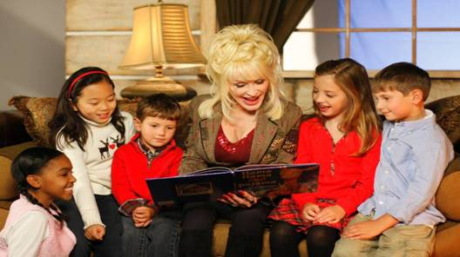
Imagining… Dolly Parton’s
Imagination Library
https://youtu.be/fRyWw3od7Vo
Notes:
Presenter Notes:
(Video link is 61/2 minutes. If you use, preface that this was recorded in 2010. A bit “corny” but good overview of the formation and details of the program. Following slides are updated).
Our Goal: To promote the love of reading and support parent interaction. We are seeking a Champion in our community help us make this opportunity available in our community.

Slide 7
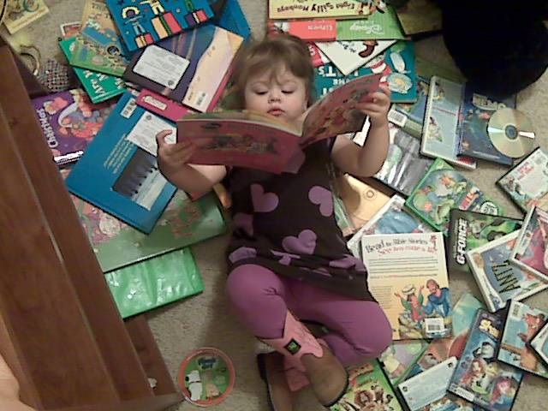
Background
Started in 1995 by Dolly Parton for the children
in her hometown of Sevier County
Inspires a love of reading
Guarantees all children will have quality books at home
A program that was created by inspiration to empower imaginations
Notes:
Presenter Note: (Sevier is pronounced severe) If you don’t play the video, comment that Dolly Parton started to program in honor of her father who never learned to read but valued education and reading. Dolly’s humble childhood inspired her desire to see that every child had books of their own.

Slide 8
From Grassroots Project to Global Movement
In 2000, expanded from Sevier County & launched nationwide replication
Launched in Canada in 2006
Launched in UK in 2007
Now also serving Australia
As of 2017 over 1 million US children served.
Globally nearly 93 million books mailed to date

Slide 9
How the Program Works…
The Dollywood Foundation partners with communities willing to bring this gift to the children of their area
Children who are registered with the program receive a free, age appropriate book each month from birth until the age of 5

Slide 10
How the Program Works…
Community Partners fund the cost of the books, postage and mailing
Community Partners register children and promote the program
The Dollywood Foundation covers all the administrative costs
Books are mailed directly to the child’s home

Slide 11
What are the Benefits?
Promotes and encourages a love of reading among children
Promotes parent-child interaction and bonding
Helps ensure that children enter kindergarten with a strong ability to read and an eagerness to learn
Strengthens the literacy level of our community
Provides FREE, high-quality, age-appropriate books to children

Slide 12
The Cost…
USA =
$2.50/child/month
$30/child/year

Slide 13
Project Target …
The Council is seeking to launch the Imagination Library serving Hanover zip codes that have the highest level of students receiving free and reduced lunch – an indicator of greatest need.
Zip Codes: 23005 (Ashland) and 23111 (Mechanicsville)
Note: Zip Code 23047 (Doswell) is currently served being served. (227-2036)
Based upon the program guidelines, any child that meets the residency and age criteria would be eligible to participate.
Notes:
Presenter Notes:
Also, for reference, Tish Iorio is the contact and coordinator of the Doswell program 227-2036. She only has 7 children as of Aug 2017, would love to serve more in Doswell zip.

Slide 14
Your Part…
Champion to Coordinate Logistics
(Registrations/Communications/Fiscal Management with Dolly Parton Foundation)
Marketing Manager
Nonprofit Sponsor as Fiscal Agent
Funding/Donations
Notes:
Presenter Notes: To make this a reality we need the following, track the children you have, the system ships the books for you. could be the same contact for multiple roles. Registrations are online or written form. Website has a log to track the children you are serving. The system sends the books and keeps up with their age and appropriate titles that are sent and when they graduate. We can help with the training, Ms. Iorio offered to assist with this.

Slide 15
Join Us…Impact Literacy & Competency In our Community
Notes:
Presenter Notes: Closing –Questions? Hope that you will join us to make an impact in the lives of each child we can reach to share the love of reading.

Slide 16
Rotary Club of Herndon
Started Imagination Library
Project 2005
Registrations as of 2013:
20170 Zip Code: 460 Children
614 Graduated
20171 Zip Code: 137 Children
20 Graduated
Notes:
EXTRA SLIDE AS EXAMPLE OF HERNDON’S Project

Slide 17
Project Target …
Place Holder
For Data
On projected costs
Notes:
Presenter Notes: We need the stats on what the projections of program costs would be!!! We can add here.

